Slide 1

Predicting State Voting Preferences at the UN
Data Science Certificate - Cohort 27
Georgetown University
Reshad Amini, Husanjot Chahal, Jordan Moeny

Slide 2
Agenda
Research and Inspiration
Data Ingestion and Wrangling
Exploratory Data Analysis and Feature Analysis
Modeling and Application
Future Work and Beyond

Slide 3
Research & Inspiration

Slide 4
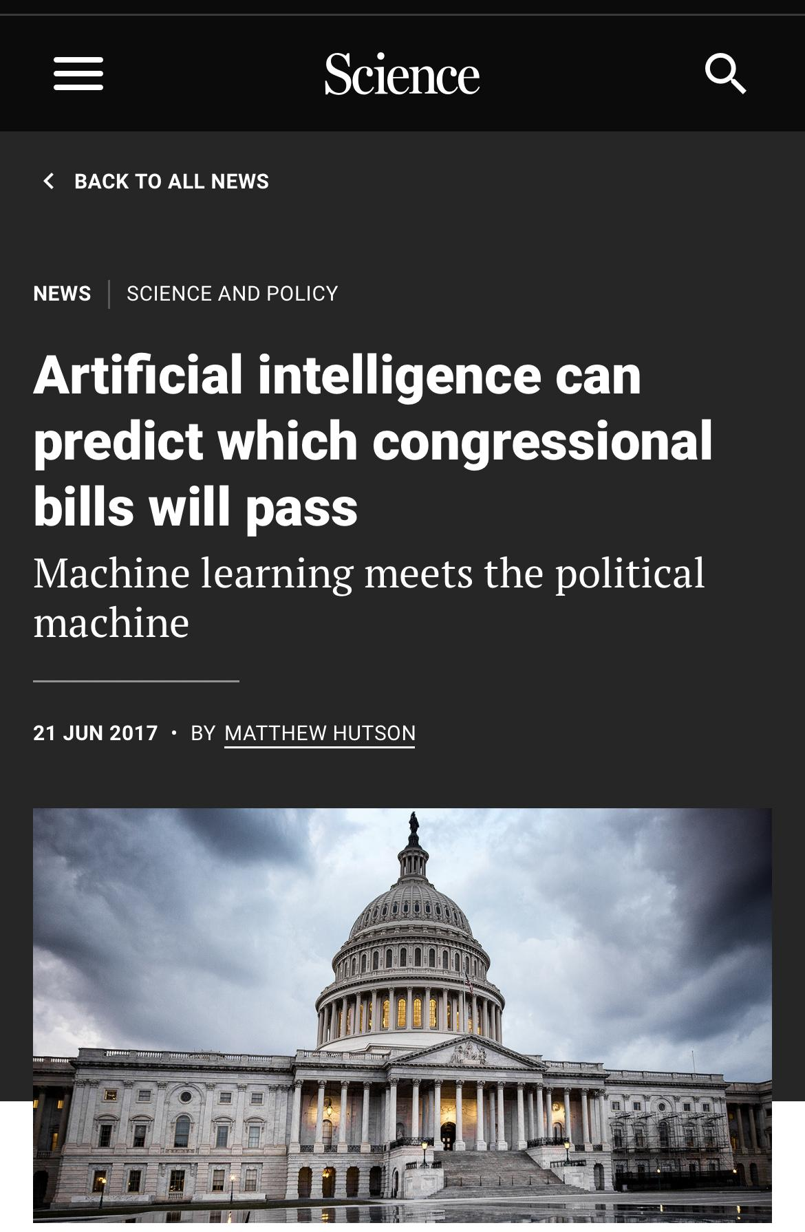
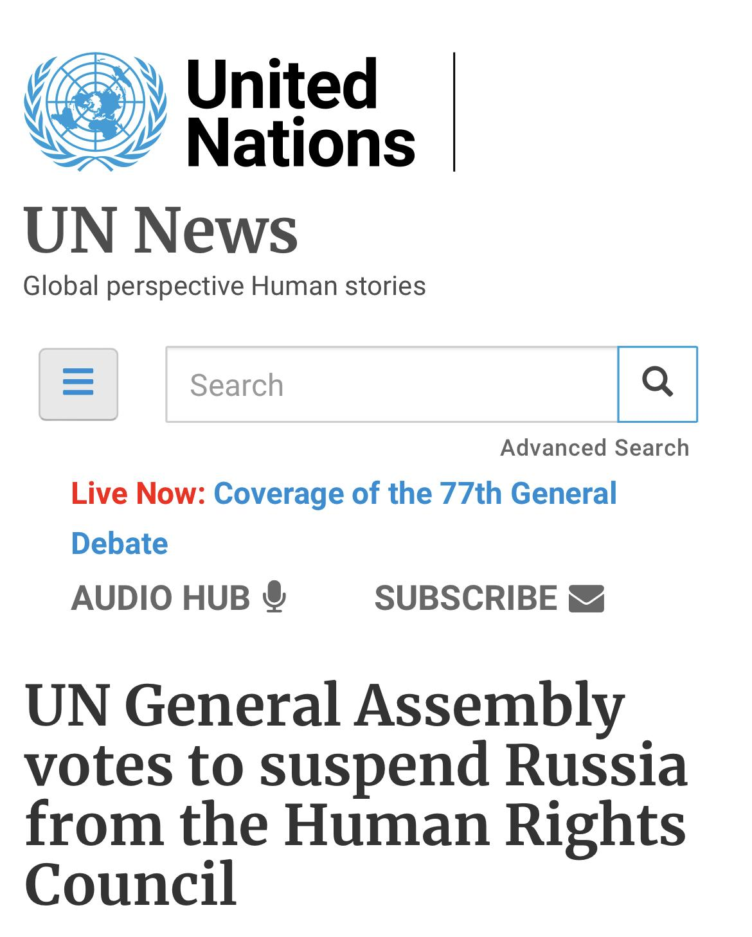
Background Research

Slide 5
Hypothesis and Motivation
Motivation
Goal
Hypothesis
Personal interest in IR.
Build a data product that can predict state preferences on resolutions passed at the UN (General Assembly and Security Council).
A country’s historical voting correlation with the world powers (specifically, the five permanent members of the UNSC) is a stronger predictor of how it will vote in the future than the issue at hand.

Slide 6






Data Science Pipeline
Data Ingestion
Data Storage
Wrangling
EDA/Feature Analysis
Modeling & Application
Reporting & Visualization
CSV, Excel
Google Drive, SQLite
DB Browser, Jupyter notebook, Colab, Python, Pandas
Pandas, Numpy, Scikitlearn, Seaborn, NLTK
Scikitlearn, Yellowbrick
Yellowbrick, Seaborn, Matplotlib, Github

Slide 7
Data Ingestion, Wrangling,
and Exploratory Analysis

Slide 8
Our Data
Two key datasets:
“United Nations voting database” from Guy Barash on Kaggle
Includes all SC and GA votes, with each country split into its own column
BUT truncates resolution titles
Voting record provided by request from the United Nations
Includes all SC and GA votes, including their full titles
BUT the full voting record is in a single cell

Slide 9
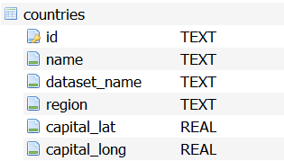
Countries
259 country names
27 duplicates
33 name changes
1 deletion
Final total: 199 countries (including 5 defunct states)

Slide 10
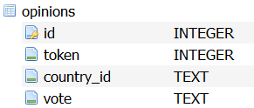
Opinions
opinion = one country’s vote on one resolution
895,877 opinions total

Slide 11
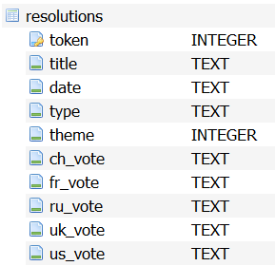
Resolutions
7851 resolutions
5234 General Assembly
2617 Security Council
12 themes:
Economics, Colonialism, Nuclear, Human rights, Middle East, Africa, Europe & Mediterranean, Asia, Security & Military, Americas, General & Admin, Unclassified

Slide 12
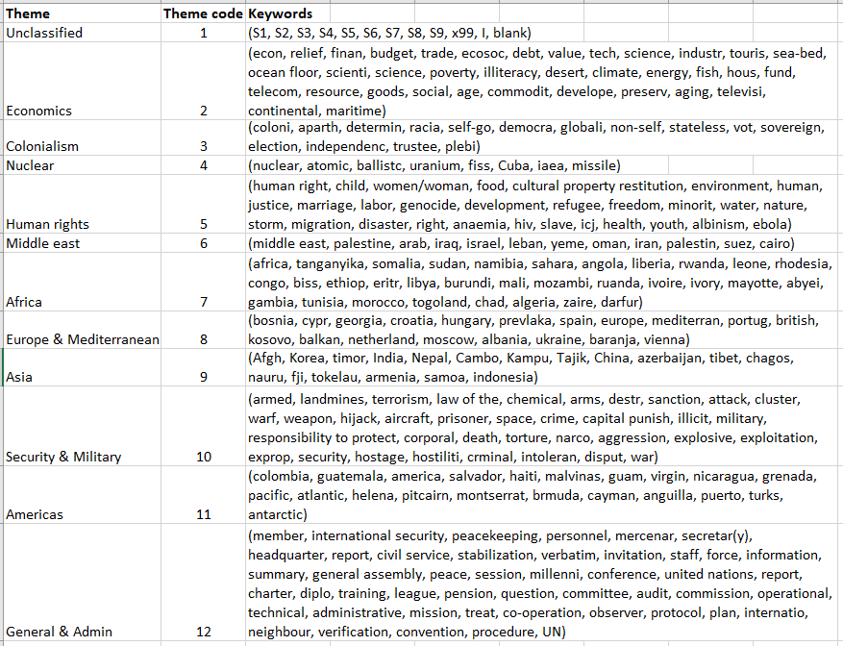
Feature Engineering: Theme extraction
The topic at hand?
7,855 full resolution titles vs. 1,548 topic tags
Tried manually first, as backup
Decided to try NLP and clustering of full titles

Slide 13
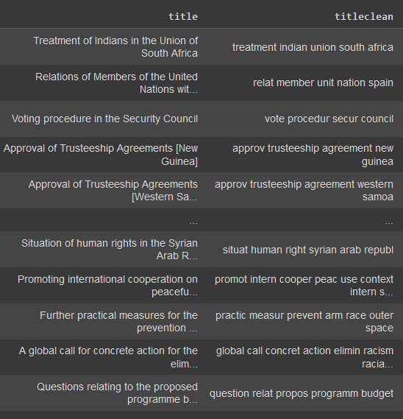
Feature Engineering - Theme extraction
lowercase
Remove stop words, numbers, extra spaces, punctuation
Stemming vs. lemmatization
Leakage risk
Bag-of-words: 29,400 → 8,064 → 2,919 unique words using TFIDF vectorization

Slide 14
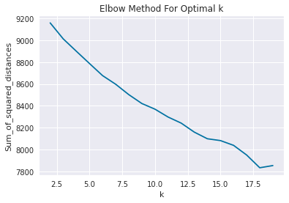
Feature Engineering - Theme extraction
BERT, HBDScan, kmeans++
Elbow method
Persistent imbalance - could be accurate?
Human interpretability

Slide 15
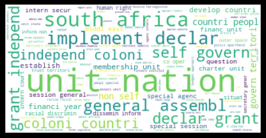
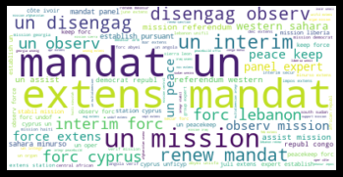
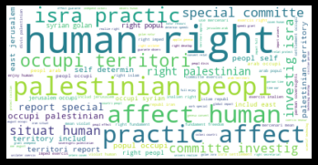
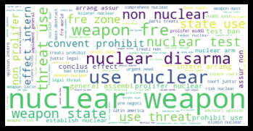
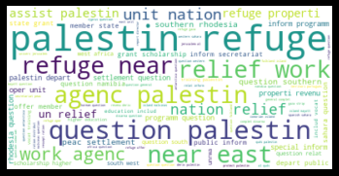
Feature Engineering

Slide 16
Exploratory Statistics
Vote | Median | Mean | Standard Deviation
Yes | .778 | .741 | .148
No | .015 | .049 | .065
Abstain | .075 | .109 | .077
Absent | .049 | .101 | .123

Slide 17
Exploratory Statistics
Country | Yes | No | Abstain
Malaysia | .932 | .013 | .049
Tunisia | .929 | .007 | .045
Bahrain | .925 | .008 | .049
Mexico | .925 | .003 | .065
Guyana | .924 | .004 | .041
Country | Yes | No | Abstain
Israel | .301 | .396 | .065
USA | .486 | .347 | .156
Micronesia | .359 | .262 | .194
Marshall Islands | .442. | .248 | .178
Palau | .274 | .229 | .120

Slide 18
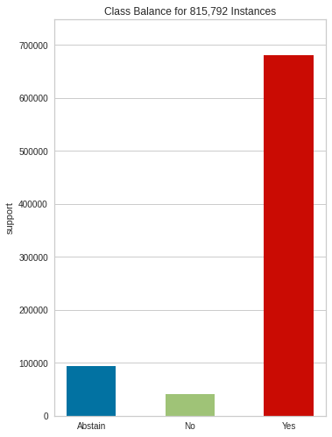
Encoding & Sampling
Ordinal Encoding vs. One Hot Encoding
Class Imbalance:
Yes: 680,949
Abstain: 93,629
No: 41,214

Slide 19
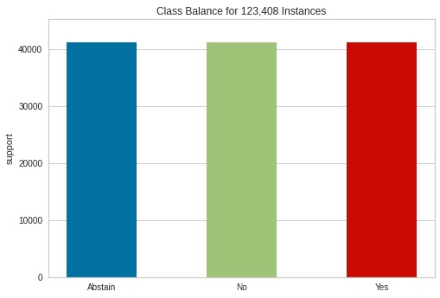
Encoding & Sampling
Ordinal Encoding vs. One Hot Encoding
Class Imbalance: Undersampling
Yes: 41,136
Abstain: 41,136
No: 41,136

Slide 20
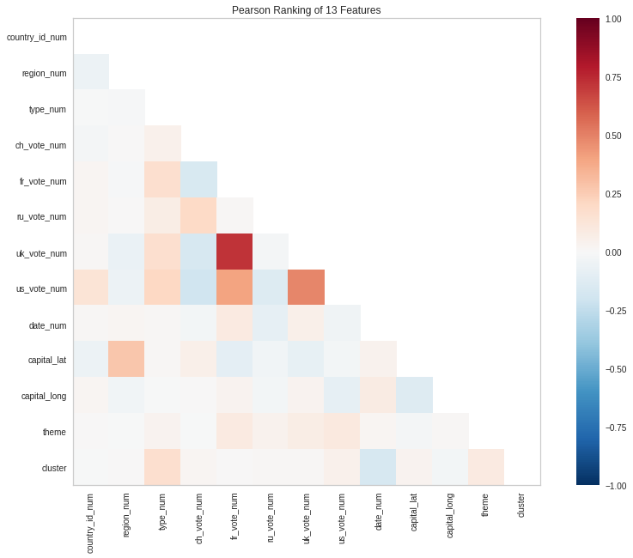
Feature Analysis:
Pearson’s Correlation

Slide 21
Modeling & Application

Slide 22
Narrowing Down Models
Classification Reports

Slide 23
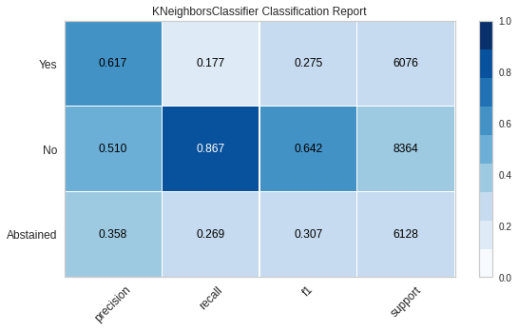
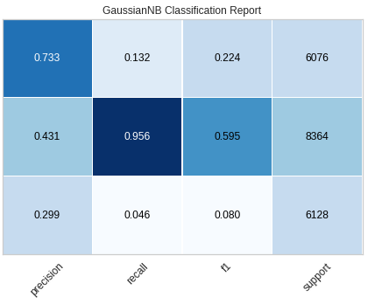
Classification Reports: k-Nearest Neighbors and Gaussian Naive Bayes

Slide 24
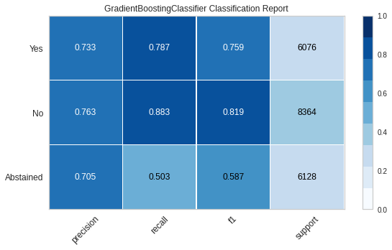
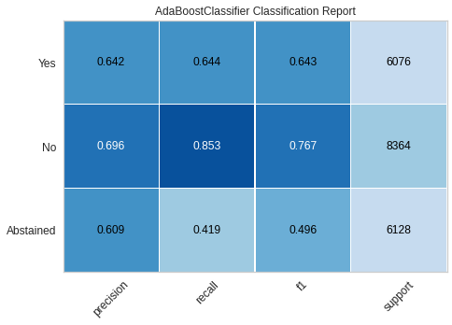
Classification Reports: Gradient Boosting and Ada Boost

Slide 25
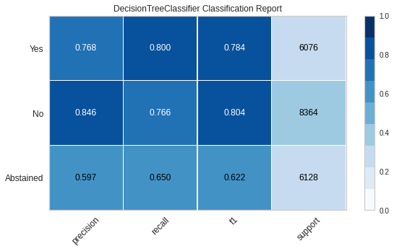
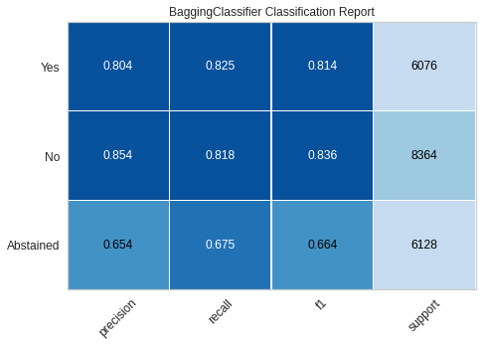
Classification Reports: Decision Tree and Extra Trees

Slide 26
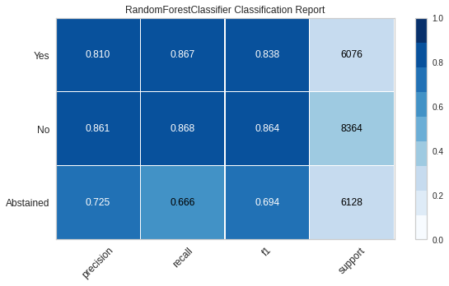
Classification Reports: Decision Tree and Extra Trees

Slide 27
Narrowing Down Models
Comparing Scores

Slide 28
F1, Precision, and Recall
Model | F1 Score | Precision | Recall
Random Forest | .803 | .803 | .805
Bagging | .767 | .769 | .766
Decision Tree | .745 | .749 | .743

Slide 29
Narrowing Down Models
ROC/AUC

Slide 30
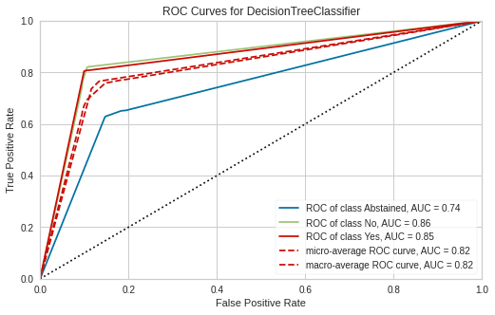
ROC/AUC: Decision Tree

Slide 31
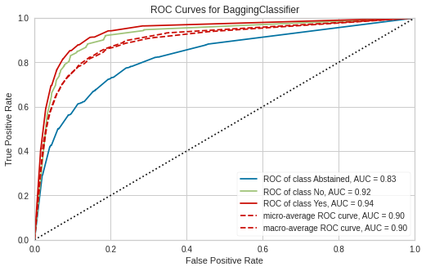
ROC/AUC: Bagging

Slide 32
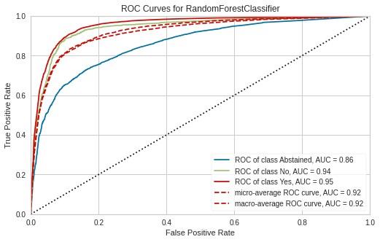
ROC/AUC: Random Forest

Slide 33
Narrowing Down Models
Confusion Matrices

Slide 34
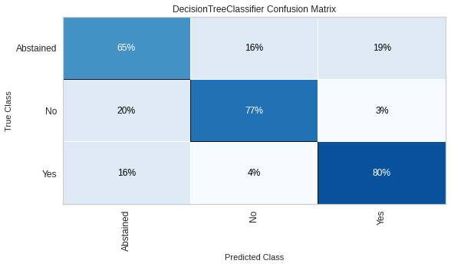
Confusion Matrix: Decision Tree

Slide 35
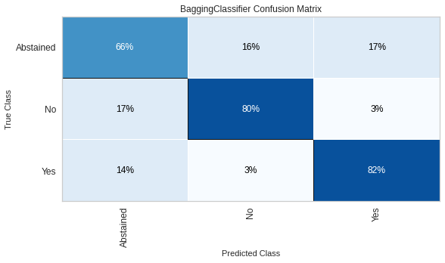
Confusion Matrix: Bagging

Slide 36
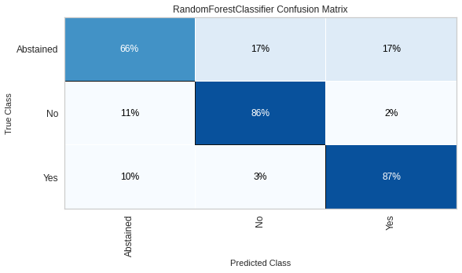
Confusion Matrix: Random Forest

Slide 37
Adjusting the Model

Slide 38
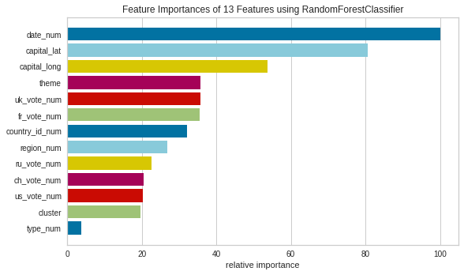
Feature Importance - Random Forest

Slide 39
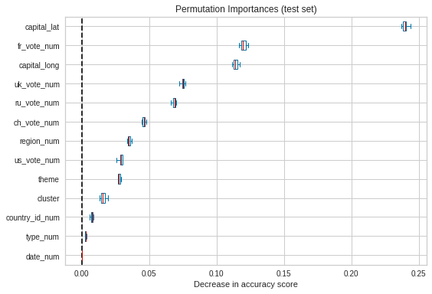
Permutation Importance - Random Forest

Slide 40
Parameters and Tuning
Key parameters: n_estimators and max_features
Adjustments in these parameters led to extremely minimal improvements at best

Slide 41
Final Results (full dataset)
f1: 0.745
precision: 0.749
recall: 0.742

Slide 42
Future Direction & Limitations

Slide 43

Limitations
Mostly categorical variables in the dataset
Memory limitations
Dependency issues
Knowledge beyond pandas, sklearn

Slide 44

Future Research
Further automated categorization of resolutions
Incorporation of additional country-specific data
GDP
Population growth
Membership in international organizations
Clustering to determine “blocs” of countries based on their votes

Slide 45
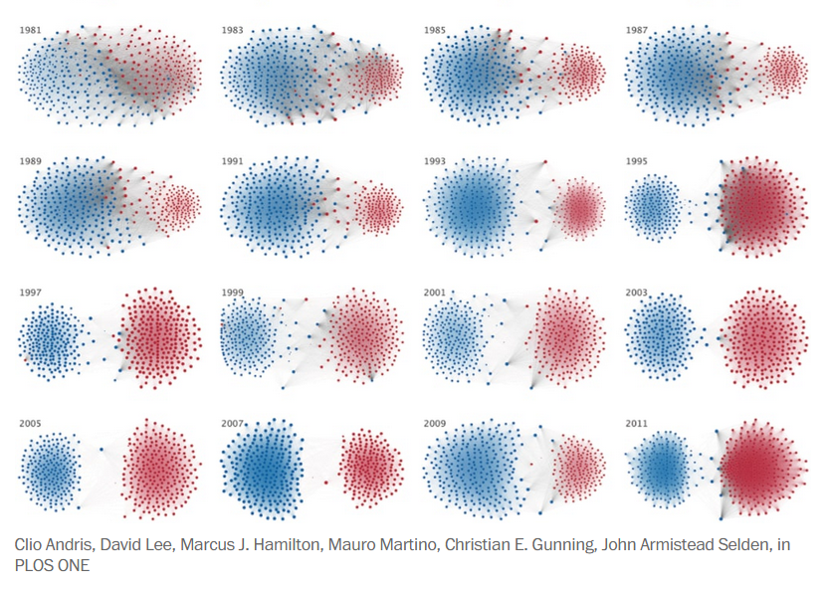
Future Products
Tool with country and theme drop-downs that generates predictions for upcoming UNGA sessions
Graphic or interactive that shows all nations’ polarity/ allegiance with 5 SC powers shifting over time via clustering

Slide 46

Thank you instructors!

